Slide 1
MAY THE 4TH BE WITH YOU!!
This Photo by Unknown Author is licensed under CC BY-SA
STAR WARS TRIVIA

Slide 2
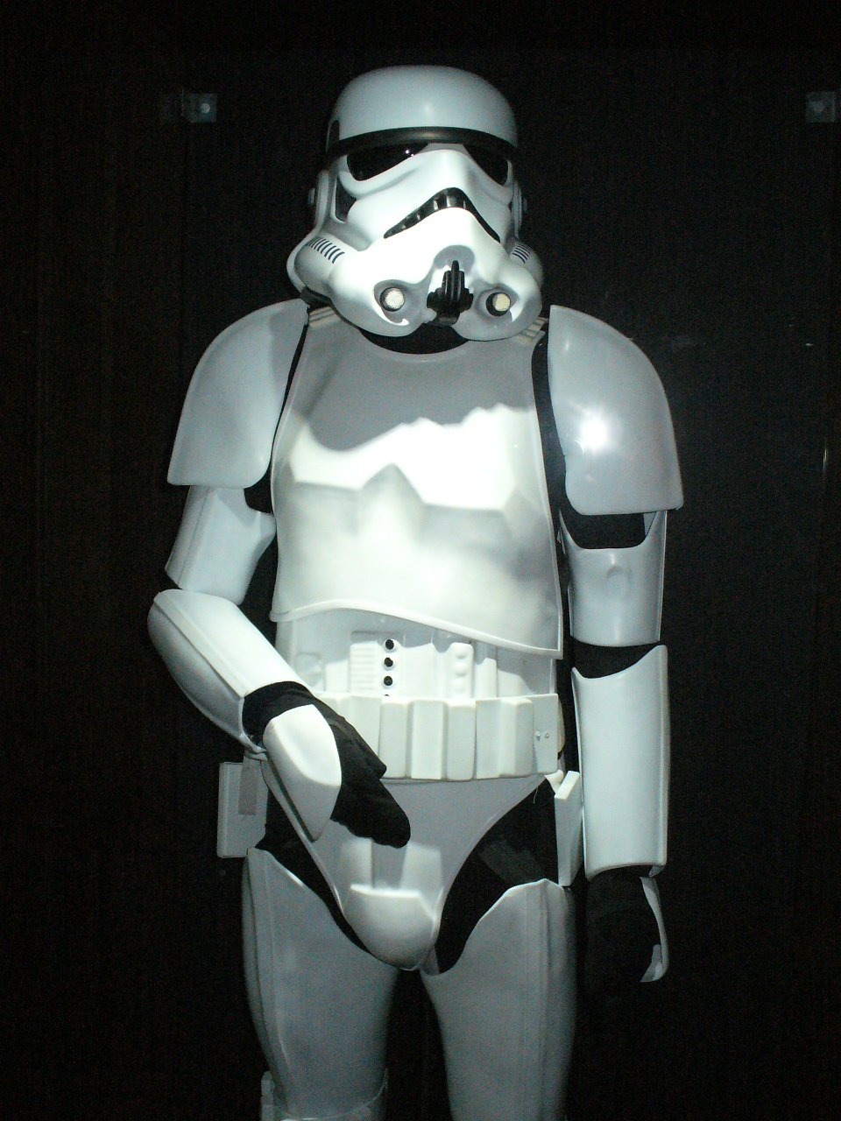
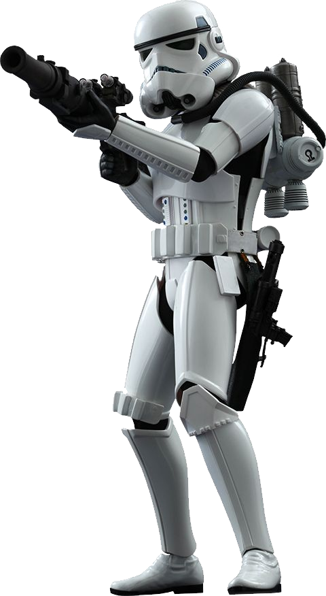
In the Star Wars movies, what are these called?
This Photo by Unknown Author is licensed under CC BY-SA
This Photo by Unknown Author is licensed under CC BY-NC
This Photo by Unknown Author is licensed under CC BY-SA-NC

Slide 3
Did you guess…
STORMTROOPER
That’s Correct!
This Photo by Unknown Author is licensed under CC BY-SA-NC

Slide 4
What is the colour of Obi-Wan’s Lightsaber?
This Photo by Unknown Author is licensed under CC BY-SA

Slide 5
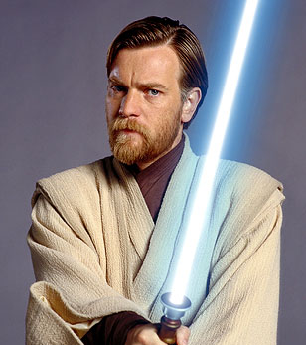
Did you guess…
BLUE
That’s Correct!
This Photo by Unknown Author is licensed under CC BY-SA

Slide 6
What is R2-D2’s name often shortened to?
This Photo by Unknown Author is licensed under CC BY-SA

Slide 7
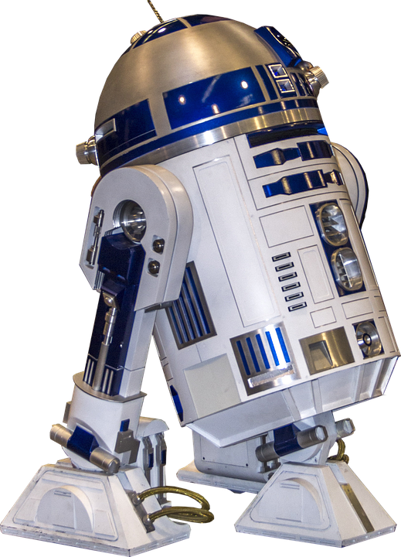
Did you guess…
R2
That’s Correct!

Slide 8
Where is Chewbacca’s home world?
This Photo by Unknown Author is licensed under CC BY-SA

Slide 9
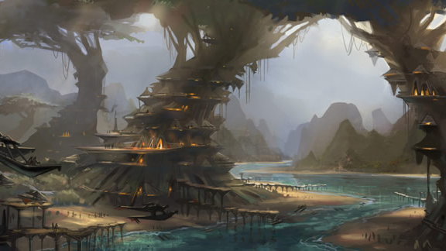
Did you guess…
Kashyyyk
That’s Correct!
This Photo by Unknown Author is licensed under CC BY-NC-ND

Slide 10
What is the invisible power that binds the galaxy together?
This Photo by Unknown Author is licensed under CC BY-SA

Slide 11
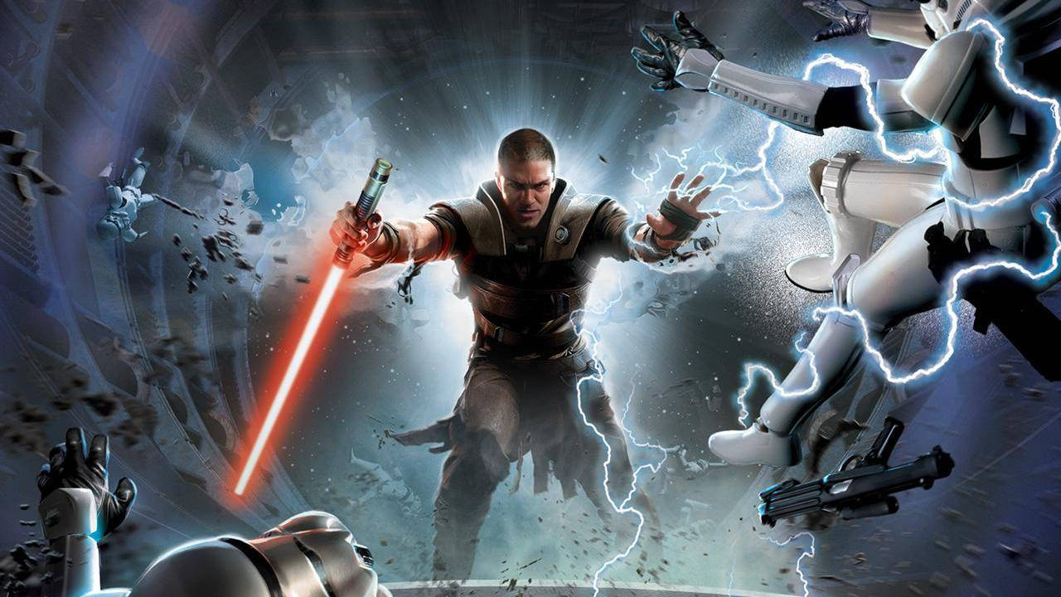
Did you guess…
The Force
That’s Correct!
This Photo by Unknown Author is licensed under CC BY-SA-NC

Slide 12
Who are the masters of The Dark Side who want to rule the Galaxy?
This Photo by Unknown Author is licensed under CC BY-SA

Slide 13
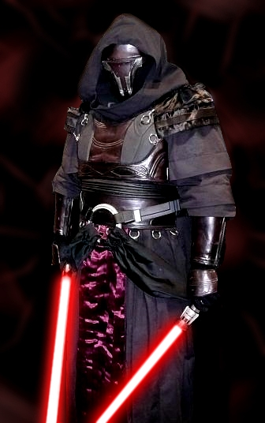
Did you guess…
The Sith
That’s Correct!
This Photo by Unknown Author is licensed under CC BY-SA

Slide 14
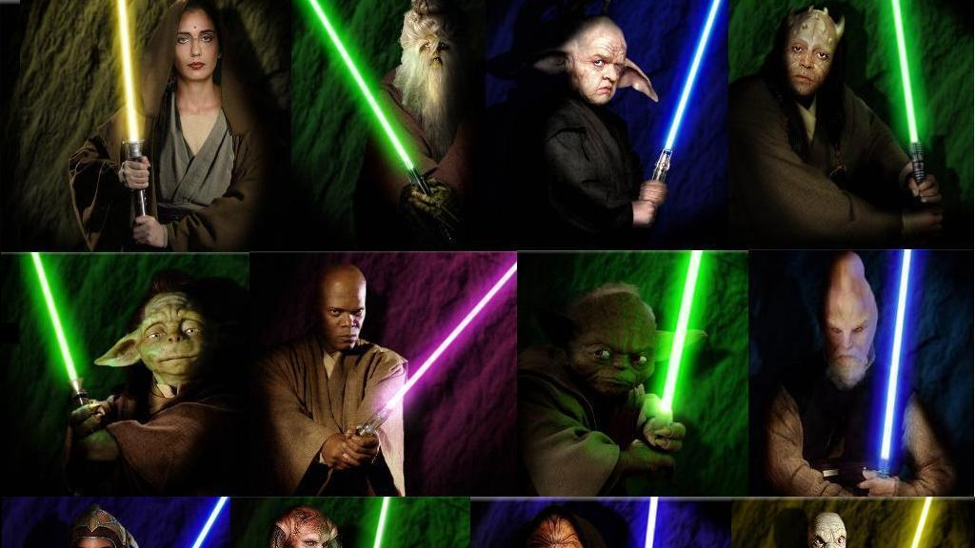
Who is the legendary Jedi Master who has trained Jedi for over 800 years?
This Photo by Unknown Author is licensed under CC BY-SA

Slide 15
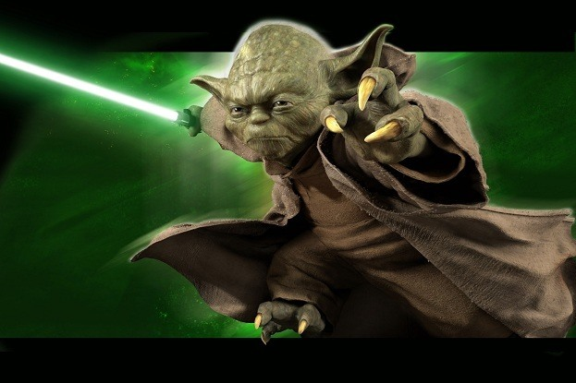
Did you guess…
Yoda
That’s Correct!
This Photo by Unknown Author is licensed under CC BY-NC

Slide 16
What were the last words spoken in The Empire Strikes Back?
This Photo by Unknown Author is licensed under CC BY-SA-NC
This Photo by Unknown Author is licensed under CC BY-SA-NC

Slide 17
Did you guess…
May The Force Be With You
That’s Correct!
This Photo by Unknown Author is licensed under CC BY

Slide 18
THANKS FOR PLAYING!
This Photo by Unknown Author is licensed under CC BY

